Slide 1
Bank Management Lecture #9
Bülent Şenver
bulentsenver@gmail.com

Slide 2
We will Learn This Week?
1. Types of Interest Risks
2. Bank Interest Strategies
3. Loan Management
4. Types of Loans
5. Types of Loan Risks
6. 6 C’s of Loan Management
7. 5 P’s of Loan Management

Slide 3
Interest Risks

Slide 4
Banking Risks – Interest Risk
Interest Risk:
“The risk of making losses by a bank due to the changes in Interest Income and/or Interest Expense of the bank arising from either changes in market conditions or changes in the interest characteristics of the bank’s Interest Earning assets and/or Interest Bearing Liabilities”

Slide 5
Banking Risks – Interest Risks
1. Interest Rate Risk
2. Interest Sensitivity Gap Risk
3. Basis Risk
4. Embedded Option Risk
5. Yield Curve Risk
6. Price Risk
7. Reinvestment Risk
8. Net Interest Position Risk

Slide 6
Interest Sensitivity Gap Strategy (IRSA-IRSL)
Strategy Interest | Interest Rates expected to Increase | Interest Rates expected to Decrease
Positive IRS GAP | Yes | No
Negative IRS GAP | No | Yes

Slide 7
Loan Management

Slide 8
Loan Management-Loan Types
Borrower type: -Retail (individual) Loans -Corporate Loans
Maturity type: -Short-term Loans -Medium-term Loans -Long-term Loans

Slide 9
Loan Management-Loan Types
Currency type: -Local Currency Loans -Foreign Currency Loans
Where used: -Working capital Loans -Consumer Loan -Import Loans -Mortgage Loan -Export Loans -Auto Loan -Investment Loan -Credit Card Loan

Slide 10
Loan Management-Loan Types
Security type: -Secured Loans -Unsecured Loans
Risk type: -Cash Loans (shown on balance sheet) -Non-Cash Loans (shown as off balance sheet item) e.g. Contingent Liabilities and Commitments

Slide 11
Loan Management-Loan Risk
1. Default Risk, collection, recoverability risk
2. Yield Risk, return risk
3. Concentration risk
4. Diminishing security risk
5. Ethical risk
6. Big Loan Risk
7. Country Risk
8. Sovereign Risk

Slide 12
Loan Management-Loan Risk
9.Compliance risk
10.Indemnification risk
11.Excessive Loan Growth risk
12.NPL Non-Performing Loan growth risk
13.Maturity missmatch risk
14.Profitability, yield risk
15.Capital Adequacy need risk
16.Reputation Risk due to illegal loan pocess

Slide 13
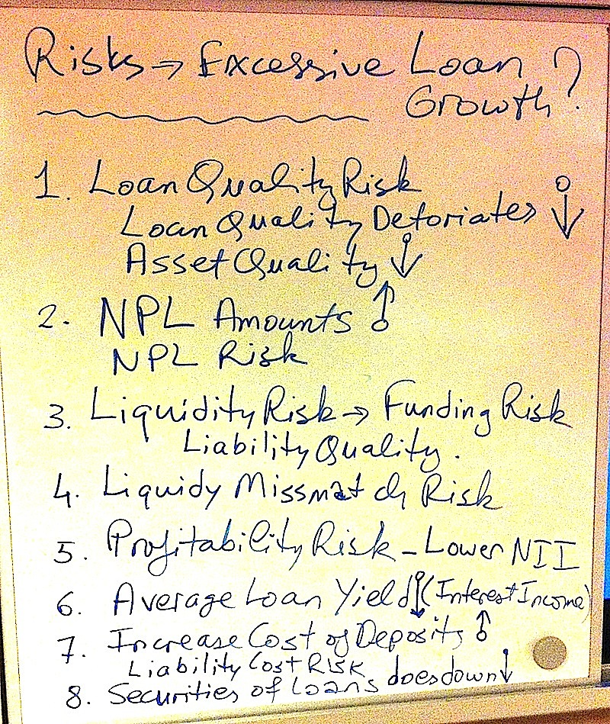

Slide 14
6 C’s of Loan Management
1. Capacity- The ability of a borrower to pay the loan back.
2. Character- Willingness of the borrower to pay the loan back
3. Capital – Is the borrower’s existing capital sufficient? Can the borrower’s share holders increase the capital of the company when needed?

Slide 15
6 C’s of Loan Management
4. Collateral- Can the borrower give to the bank proper collateral, guarantee to cover the loan in case there is a default in future?
5. Conditions- Is country, sector, holding, company & loan conditions suitable to give the loan?
6. Compliance- Does the bank & the borrower comply with laws, regulations & ethics?

Slide 16
5 P’s of Non Performing Loans
How to control NPL?
1. Philosophy
2. Policies
3. Procedures
4. Pricing
5. People

