Slide 1
Bank Management Lecture #6
Bülent Şenver
bulentsenver@gmail.com

Slide 2
We will Learn This Week?
Banking Risks Categorisation Method
Bank Financial Risks
Bank analytics & Policy Risks
Bank Operation Risks
5 CAMEL-SO Banking Risks
Capital adequacy risk
Asset quality risk
Management quality risk
Earnings, Efficiency, profitability risk
Liquidity risk
Operations risk
Sensitivity risk

Slide 3
BANKING RISKS
Risks

Slide 4
Types of Risks
Risks in Banks
Specific Risk
Share Risk
Transaction
Risk
Market Risk
General Market
Risk
Interest Rate Risk
Structural
Interest
Rate Risk
Credit Risk
Exchange Rate Risk
Commodity Risk
Liquidity Risk
Banking
Risks
Counterparty
Credit Risk
Operational
Risk
Transaction &
Business Risk
Issuer Risk
Reputation
Risk
Concentration
Risk
Issuing Risk
Business &
Strategic Risks

Slide 6
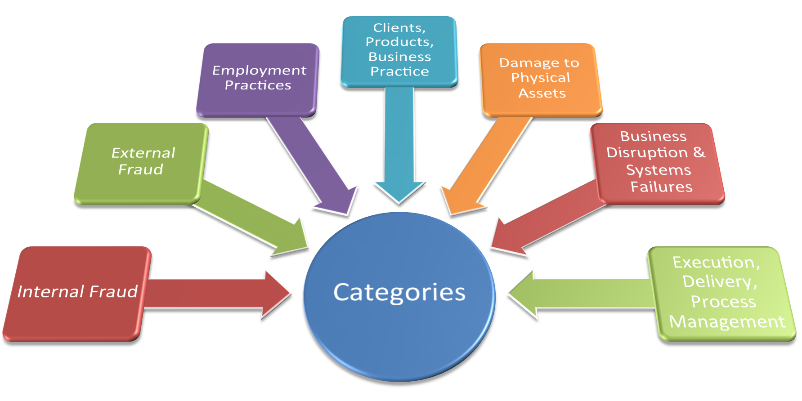
Operations Risks
Internal Fraud
External Fraud
Practices:
- Employment
- Client
- Products
- Business
Damage to Assets
Business Disruption
System Failures
Process
Management
Execution
Delivery

Slide 7
CAMEL
RISKS

Slide 8
Banking Risks – CAMEL-OS
Capital adequacy risk
Asset quality risk
Management quality risk
Earnings, Efficiency, profitability risk
Liquidity risk
Operations risk
Sensitivity risk

Slide 9
Balance Sheet does not show all the Banking Risks
Assets. =
Liabilities + Share Holders Equity
Why did banks hide their risks?
Interest Earning Assets
Interest Bearing Liabilities
Non IBL Liabilities
Non IEA assets
Shareholders Equity
How did banks hide their risks?

Slide 10
Capital Adequacy Ratio 12%
Shareholders Equity
Capitap Adequacy Ratio =
Share Holders Equity ---------------------------- Risk1 + Risk2 + Risk3
Risk1 = Risk Weighted Assets
Risk2 = Market Risks
Risk3 = Operations Risk

Slide 11
Banking Risks – Liquidity Risk
Liquidity Risk:
“The inability of a bank to fulfill its obligations when they became due and/or the inability of a bank to perform its daily banking operations after fulfilling its obligations due to lack of cash or liquid assets”

Slide 12
Types of Liquidity Risks
1. Funding Risk
2. Time Risk
3. Call Risk
4. Excessive Asset Growth Risk

Slide 13
Types of Liquidity Risks
Liquidity Risks:
1. Funding Risk – FR is related with the Balance Sheet Liabilities of the bank. FR arises when there is unexpected early withdrawal of deposits before the maturity date (due date) or unexpected non-renewal of deposits at the maturity date.

Slide 14
Types of Liquidity Risks
Liquidity Risks:
2. Time Risk - TR is related with the Balance Sheet Assets of the bank. TR arises when there is an unexpected non-payment of loan principal or interest amount (loan default) at the due date (maturity date) or when there is unexpected early payment of loan principal amount before its maturity date (closing the loan before the maturity date)

Slide 15
Types of Liquidity Risks
Liquidity Risks:
3. Call Risk – CR is related with the Off-Balance Sheet items ”Contingent Liabilities & Commitments” of the bank. CR arises when there is an unexpected indemnification of a Contingent Liability or Commitment. The bank is force to make payment on behalf of its customer because of the guarantee given by the bank.

Slide 16
Types of Liquidity Risks
Liquidity Risks:
4. Excessive Asset Growth Risk – EAG risk arises when a bank wants to grow its assets; especially grow its Loan Portfolio with such a high speed that the treasury department of the bank can not find sufficient funds with reasonable terms & conditions to give these loans.

