Slide 1
Bank Management Lecture #5
Bülent Şenver
bulentsenver@gmail.com

Slide 2
We will Learn This Week?
Central Bank Services Given to Banks
Central Bank Stratagy & Targets
Should Central Banks be Independent?
Banking Risks Categorisation Method
CAMEL-SO Banking Risks

Slide 3
Central Bank Services given to Banks
1. Current Account service
2. Deposit Reserve Account service
3. Cheque Clearing House service
4. Interbank Market services
5. Bounced Cheques List
6. Protested Bills List

Slide 4
Central Bank Services given to Banks
7. Determine indicative Interest Rates
8. Determine indicative Exchange Rates
9. Risk Centralization service
10. Hard Currency Supply (paper & coins)
11. REPO and Reverse REPO & SWAP services
12. Rediscount Window Facility

Slide 5
Central Bank Strategy: Use of Targets
Central Bank Strategy

Slide 6
Should the Fed (Central Bank) Be Independent?
Every few years, the question arises in Congress as to whether the independence of the Fed should be reduced in some fashion. This is usually motivated by politicians who disagree with current Fed policy.
Arguments can be made both ways, as we outline next.

Slide 7
Case for Independence
The strongest argument for independence is the view that political pressure will tend to add an inflationary bias to monetary policy. This stems from short-sighted goals of politicians. For example, in the short-run, high money growth does lead to lower interest rates. In the long-run, however, this also leads to higher inflation.

Slide 8
Case for Independence
The notion of the political business cycle stems from the previous argument.
Expansionary monetary policy leads to lower unemployment and lower interest rates—a good idea just before elections.
Post-election, this policy leads to higher inflation, and therefore, higher interest rates—effects that hopefully disappear (or are forgotten) by the next election.

Slide 9
Case for Independence
Other arguments include:
The Treasury may seek to finance the government through bonds purchased by the Fed. This may lead to an inflationary bias.
Politicians have repeatedly shown an inability to make hard choices for the good of the economy that may adversely affect their own well-being.
Its independence allows the Fed to pursue policies that are politically unpopular, yet in the best interest of the public.

Slide 10
Case Against Independence
Some view Fed independence as “undemocratic”—an elite group controlling an important aspect of the economy but accountable in few ways.
If this argument seems unfounded, then ask why we don’t let the other aspects of the country be controlled by an elite few. Are military issues, for example, any less complex?
Indeed, we hold the President and Congress accountable for the state of the economy, yet they have little control over one of the most important tools to direct the economy.

Slide 11
Case Against Independence
Further, the Fed has not always been successful in the past. It has made mistakes during the Great Depression and inflationary periods in the 1960s and 1970s.
Lastly, the Fed can succumb to political pressure regardless of any state of independence. This pressure may be worse with few checks and balances in place.

Slide 12
Central Bank Independence and Macroeconomic Performance Throughout the World
Empirical work suggests that countries with the most independent central banks do the best job controlling inflation.
Evidence also shows that this is achieved without negative impacts on the real economy.

Slide 13
BANKING RISKS
Risks

Slide 15
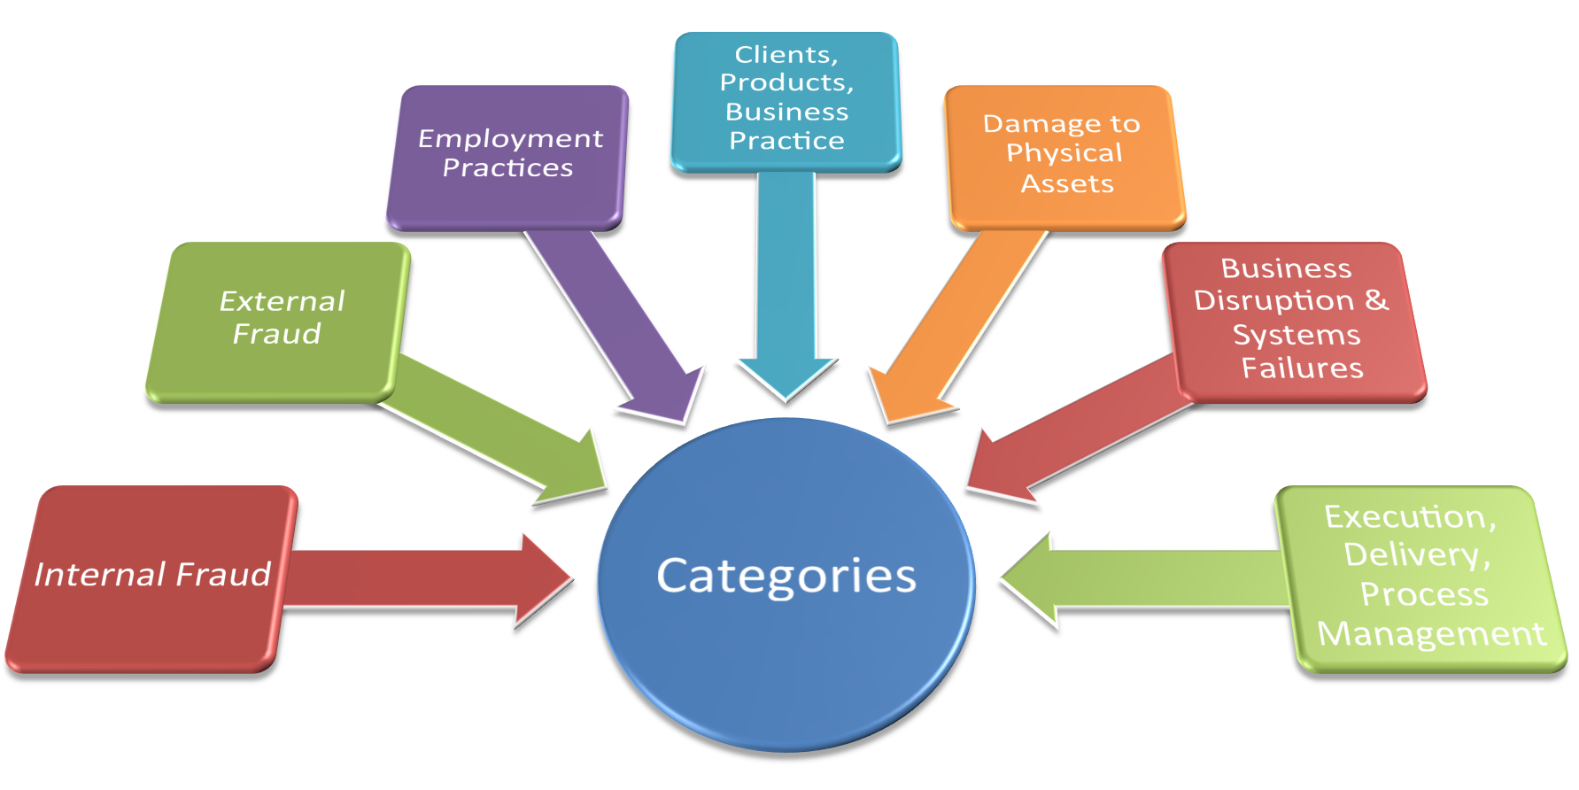
Operations Risks
Internal Fraud
External Fraud
Practices:
- Employment
- Client
- Products
- Business
Damage to Assets
Business Disruption
System Failures
Process
Management
Execution
Delivery

Slide 16
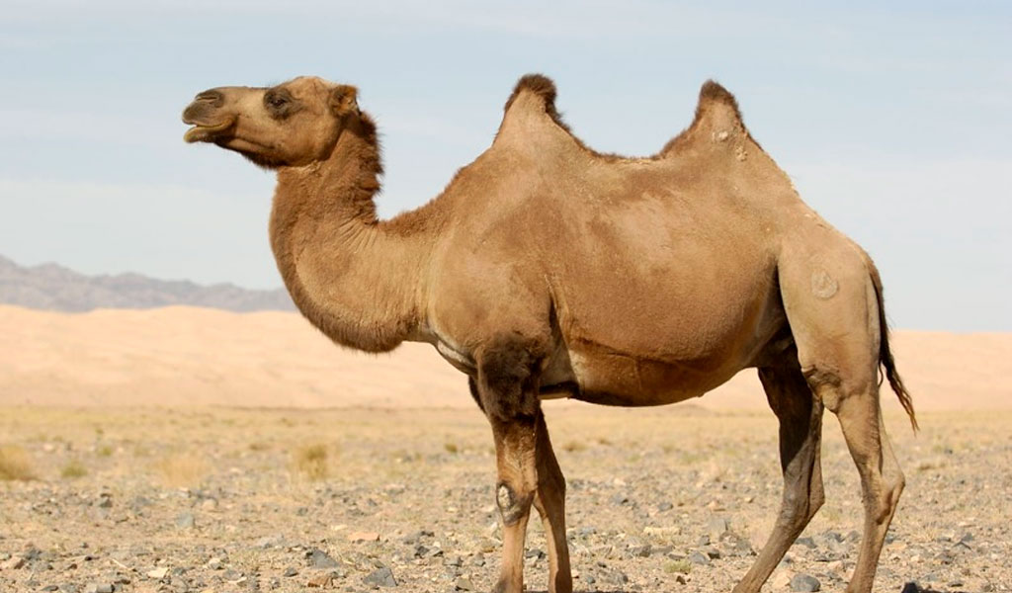
CAMEL
RISKS

Slide 17
Banking Risks – CAMEL-OS
Capital adequacy risk
Asset quality risk
Management quality risk
Earnings, Efficiency, profitability risk
Liquidity risk
Operations risk
Sensitivity risk

