Slide 1
Bank Management
Lecture #3
Bülent Şenver
bulentsenver@gmail.com

Slide 2
We will Learn This Week?
1. Financial Markets
2. Debt Markets
3. Equity Markets
4. Bank Balance Sheet & Income Statement Relationship
5. Bank Regulatory & supervisory Bodies

Slide 3
Classifications of Financial Markets
Debt Markets
  Short-Term (maturity < 1 year) Money Market
  Long-Term (maturity > 1 year) Capital Market
Equity Markets
  Common Stock

Slide 4
Characteristics of Debt Markets Instruments
Debt instruments
  Buyers of debt instruments are suppliers (of capital) to the firm, not owners of the firm
  Debt instruments have a finite life or maturity date
  Advantage is that the debt instrument is a contractual promise to pay with legal rights to enforce repayment
  Disadvantage is that return/profit is fixed or limited

Slide 5
Characteristics of Equity Markets Instruments
Equity instruments (common stock is most prevalent equity instrument)
  Buyers of common stock are owners of the firm
  Common stock has no finite life or maturity date
  Advantage of common stock is potential high income since return is not fixed or limited
  Disadvantage is that debt payments must be made before equity payments can be made

Slide 6
Characteristics of Financial Markets
Debt Markets
  Although less well-known by the average person, debt markets in U.S. are much larger in total dollars than equity markets, due to greater number of participant classes (households, businesses, government, and foreigners) and size of individual participants (businesses, and government)

Slide 7
Characteristics of Financial Markets
Equity Markets
  Although U.S. markets are highly efficient, the world’s largest, and more familiar to the average person, they are far smaller than the U.S. debt markets largely due to the fact that the only applicable participants are businesses

Slide 8
Classifications of Financial Markets
Primary Market
  New security issues sold to initial buyers
Secondary Market
  Securities previously issued are bought
  and sold

Slide 9
Classifications of Financial Markets
Exchanges
  Trades conducted in central locations
  (e.g., New York Stock Exchange)
Over-the-Counter Markets
  Dealers at different locations buy and sell
NYSE home page
http://www.nyse.com

Slide 10
Balance Sheet
Income Statement
Assets
Liabilities
Loans
Deposits
(+) Interest Income
Interest Bearing Liabilities
(IBL)
Interest Earning Assets
(IEA)
Treasury Bills
Bank Borrowings
(-) Interest Expense
NON
IBL
NON
IEA
SHEQ
Share Holders’ Equity
= Net Interest Income
(NII)
Share Holders’ Equity
Total Assets
=
Total Liabilities+SHEQ

Slide 11
Balance Sheet shows “Financial Position” of a Bank
Balance Sheet does not show all the Risks of Banks
Assets. =
Liabilities + Share Holders Equity
Loans
Government Bonds
treasury Bills
Interest
Earning
Assets
Interest
Bearing
Liabilities
Deposits
Bank Borrowings
Bond Issued
Non IE
Liabilities
Non IE
assets
Shareholders
Equity
100 TL =
100 TL

Slide 12
Balance Sheet Assets
Interest Earning Assets
(IEA)
1. Loans
2. Government Bonds
3. Treasury Bills
4. Company Bonds
5. Municipality Bonds
6. Commercial Papers
7. Interest Earning Derivatives
Non Interest Earning Assets
1. Cash
2. Property Plant & Equipment
3. Reserve Deposits at Central Bank
4. Equity Participations
5. Share Certificates Trading Portfolio
6. Other non interest earning assets

Slide 13
Balance Sheet Liabilities
Interest Bearing Liabilities (IBL)
1.Time Deposits
2. Bank Borrowings
3. Interbank Borrowing
4. Syndication Loans
5. Bonds issued
6. Commercial Paper Issued
7. Securitization of Assets
8. Mortgage Backed Securities issued
Non Interest Bearing Liabilities
1. Demand Deposits
2. Utility Payments collected
3. Tax payments collected
4. Prepaid Card Liabilities
5. Other Non Interest Bearing Liabilities

Slide 14
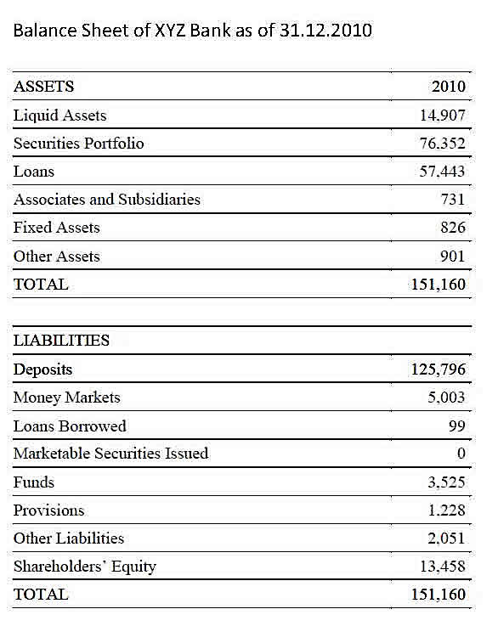
Balance Sheet XYZ Bank as of 31.12.2018

Slide 15
Income Statement Summary of a Bank
Interest Income 100
Interest expense (60)
Net Interest Income 40
Non Interest Income 30
Non Interest Expense (25)
Net Non Interest Income 5
Income Before Tax 45
Tax provision (9)
Net Income 36

Slide 16
Balance Sheet Horizontal § Vertical Analysis
 |  |  |  | Vertical | Vertical
 |  |  |  | Analysis | Analysis
 | Year 1 | Year 2 | Horizontal
ASSETS |  |  | Analysis | Year 1 | Year 2
Liquid Assets | 14907 | 16000 | 7,3% | 9,73% | 8,25%
Securities Portfolio | 76352 | 80000 | 4,8% | 49,85% | 41,24%
Loans | 57443 | 95000 | 65,4% | 37,50% | 48,97%
Associates & Subsidiaries | 731 | 800 | 9,4% | 0,48% | 0,41%
Fixed Assets | 826 | 1000 | 21,1% | 0,54% | 0,52%
Other Assets | 2911 | 1200 | -58,8% | 1,90% | 0,62%
TOTAL ASSETS | 153170 | 194000 | 26,7% | 100,00% | 100,00%

Slide 17
Balance Sheet Horizontal § Vertical Analysis
 |  |  |  | Vertical | Vertical
 |  |  |  | Analysis | Analysis
 | Year 1 | Year 2 | Horizontal | Year 1 | Year 2
LIABILITIES + SHEQ |  |  | Analysis
Deposits | 125796 | 150000 | 19,2% | 82,13% | 77,32%
Money Markets | 5003 | 10000 | 99,9% | 3,27% | 5,15%
Loans Borrowed | 99 | 200 | 102,0% | 0,06% | 0,10%
Marketable Securities Issued | 2000 | 6800 | 240,0% | 1,31% | 3,51%
Other Funds | 3525 | 4000 | 13,5% | 2,30% | 2,06%
Reserves Provisions | 1228 | 2000 | 62,9% | 0,80% | 1,03%
Other Liabilities | 2061 | 3000 | 45,6% | 1,35% | 1,55%
SHARE HOLDERS EQUITY | 13458 | 18000 | 33,7% | 8,79% | 9,28%
TOTAL Labilities & SHEQ | 153170 | 194000 | 26,7% | 100,00% | 100,00%

Slide 18
Income Statement Horizontal & Vertical Analysis
 |  |  |  | Vertical | Vertical
 |  |  | Horizontal | Analysis | Analysis
 | Year 1 | Year 2 | Analysis | Year 1 | Year 2
Interest Income | 100000 | 150000 | 50% | 100,0% | 100,0%
Interest Expense | 60000 | 95000 | 58% | 60,0% | 63,3%
Net Interest Income | 40000 | 55000 | 38% | 40,0% | 36,7%
Non Interest Income | 50000 | 60000 | 20% | 50,0% | 40,0%
Non Interest Expense | 40000 | 55000 | 38% | 40,0% | 36,7%
Net Non Interest Incme | 10000 | 5000 | -50% | 10,0% | 3,3%
Income Before Tax | 50000 | 60000 | 20% | 50,0% | 40,0%
Taxation provision | 9000 | 10800 | 20% | 9,0% | 7,2%
Net Income | 41000 | 49200 | 20% | 41,0% | 32,8%

Slide 19
Bank Regulatory, Supervision, Audit, Bodies
Central Bank (TCMB)
Supervisory Authority (BDDK)
Saving Deposit Insurance Fund (TMSF)
Security Exchange Commission (SPK)
Ministry of Finance (MB)
Anti-Money Laundering Agency (MASAK)
Independent External Auditors
Internal Auditors

