Slide 1
Bank Management
Lecture #13
Bülent Şenver
bulentsenver@gmail.com

Slide 2
We will Learn This Week?
1. Plastic Card Payment Systems
2. Types of Institutions in Card Payment Sytems
3. Different Types of Plastic Cards
4. Credit Card Process, How it Works
5. Banking Crises & Moral Hazard in Banking
6. Future of Banking

Slide 3
Plastıc Card Payment Systems
Credit Cards, Debit Cards, Caharge Cards, Prepaid Cards

Slide 4
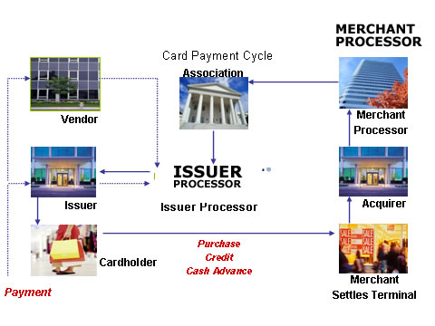
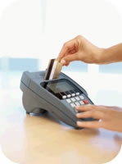

Plastic Card Payment Cycle

Slide 5
Types of Plastic Cards
Debit Card
Charge Card
Credit Card
Prepaid Card
Business Card
Purchase Card
Installment Card
Co-Branded Card
Loyalty Card
Special Purpose Card

Slide 6
Plastic Card Technology
Magnetic stripe card
Chip card
Contactless card
NFC Near Field Communication card
Virtual card
Biometrics
Mobile

Slide 7
Credit Card On-Line Authorization
Local Card
used in Turkey
BANK-A
BANK-B
BKM A.Ş.
ACQUIRER
ISSUER
Approve/Reject
Approve/Reject
I want to pay with my Credit Card
Card Holder
Merchant
Approve/Reject
7
POS machine of A Bank
Credit Card of B Bank

Slide 8
On-Us Transactions
Local Card
used in Turkey
BANK-A
ACQUIRER
Credit Card of A Bank
Approve/Reject
I want to pay with my credit card
POS machine of A Bank
Merchant
8
Card Holder

Slide 9
Issuing Bank routes it first toBKM and
BKM routes it to Visa or MasterCard
Method 1
Local Card
used
outside of Turkey
Foregin
Bank
Local Bank
VISA/MC
BANK-B
BKM A.Ş.
BANK-A
ISSUER
Approve/Reject
ACQUIRER
Approve/Reject
Approve/Reject
International
Authorisation Process is executed
Local Card Holder
I am a Turkish citizen. I want to use my card outside of Turkey
BKM can only handle the Authorisation. Cleaing and Settlement should be done with VISA and MasterCard
Approve/Reject
Foreign Merchant
9

Slide 10
If Issuing Bank is not a Local Bank the Acquiring Bank routes it first toBKM and BKM routes it to Visa or MasterCard
Method 1
Foreign Card
used
in Turkey
Foreign Bank
Local Bank
VISA/MC
BANK-B
BANK-A
BKM A.Ş.
ISSUER
ACQUIRER
Approve/Reject
Approve/Reject
Approve/Reject
I am a foreigner. I would like to pay with my credit card in Turkey
Merchant
Approve/Reject
İŞYERİ
10
POS machine of A Bank
Credit Card of a Foreign Bank

Slide 11
BANKING CRISES
Moral Hazard in Banking

Slide 12
Banking Crises USA
USA Crises:
1980 Savings Banks crises (S&L)
The Federal Reserve of the United States raised the discount Rate that it charged its member banks from 9.5 percent to 12 percent in an effort to reduce inflation.
Savings Banks § Loan Associations had issued long-term loans at fixed interest rates that were lower than the interest rate at which they could borrow.
The failure of 1,043 out of the 3,234 savings banks and loan associations

Slide 13
Banking Crises USA
2007-2008 sub-prime mortgage loans crises (Global Financial Crises) the crisis was financed with mortgage-backed securities (MBSes) and collateralized debt obligations (CDOs), which initially offered higher interest rates.
Three causes for thr crises:
1)Sub Prime Mortgage Loans
2)Increase in Federal Reserve Discount Rates & Deposit Interest Rates
3)Decrease in Property Prices

Slide 14
Banking Crises Turkey
Turkey Crises:
2000 November – Interest Risk – Demirbank
2001 March – Liquidity & Devaluation risk,
The failure of 25 out of 65 banks

Slide 15
Moral Hazard in Banking
People will take risks that they should not take if they have an incentive to do so. Risk versus Benefit. (eg. Bearings Bank, Lehman Brothers, İmar Bank)
Business Ethics
Conflict of Interest
Non Compliance with Laws & Regulations
Violation of Banking Rules & Practices

Slide 16

Ethical Paradox in Financial System
Earthquake in USA Financial System,
effected the whole world markets

Slide 17
Banking institutions are dangerous
Quote of the Week
'I believe that banking institutions are more dangerous to our liberties than standing armies. If the American people ever allow private banks to control the issue of their currency, first by inflation, then by deflation, the banks and corporations that will grow up around the banks will deprive the people of all property until their children wake-up homeless on the continent their fathers conquered.'
Thomas Jefferson 1802

Slide 18
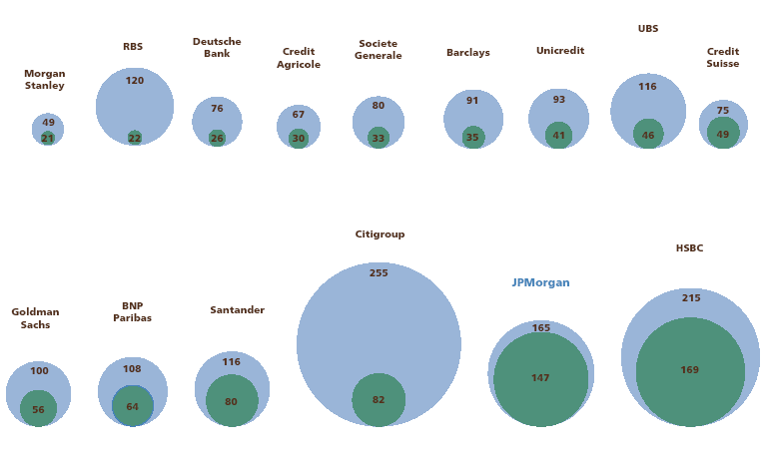
Q2’07
Market Value of Banks (bil $)
20.10.2008
Source: Bloomberg, 20.10.2008

Slide 19
Classic Banking Model.....
Assets Liabilities
Mortgage Loans
Source of Funds
Bank
Deposits
Syndiction loans
Corporate Loans
Quasi equity loans
Share holders equity

Slide 20
Securitisation & Derivatives changed classic funding model
Mortgage Loans
Mortgage Backed Securities
Risk Sharing
Senior Tranche
I
N
V
E
S
T
O
R
MBS
Mezzanine Tranche
Junior Tranche
Collateralized Debt Obligations
Corporate Loans
Senior Tranche
I
N
V
E
S
T
O
R
CDO
Mezzanine Tranche
Junior Tranche

Slide 21
Derivative products coplicated the fundind model more......
Mortgage Backed Securities
New
Collateralized Debt Obligations
MBS
Mezzanine Tranche
I
N
V
E
S
T
O
R
CDO
Corporate Loan
Collateralized
Debt Obligations
CDO
Mezzanine Tranche

Slide 22
Leverage increased
Senior Tranche
H
e
d
g
e
F
u
n
d
B
A
N
K
S
MBS
Junior Tranche
S
I
V
Senior Tranche
CDO
Junior Tranche

Slide 23
Balance Sheet does not show all the risks
Assets
Liabilities
Why did banks hide their risks?
Interest
Earning
Assets
Interest
Bearing
Liabilities
Non IE
Liabilities
Non IE
assets
Shareholders
Equity
How did banks hide their risks?

Slide 24
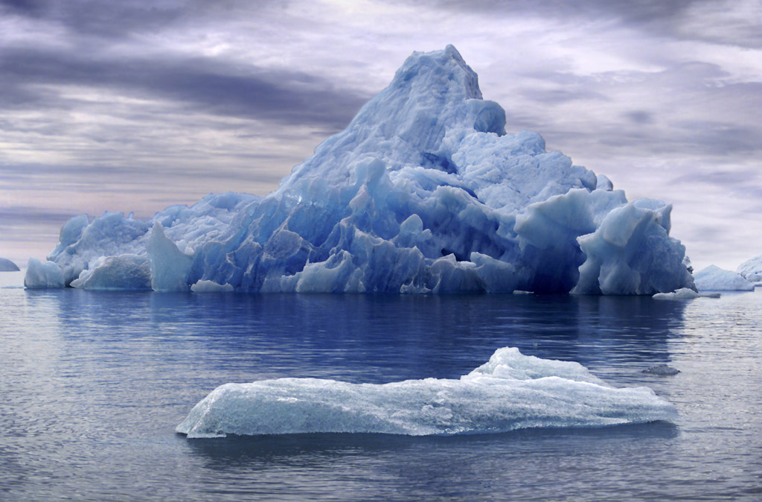
Risks shown on Balance Sheet
Notes:
www.bulentsenver.com bsenver@superonline.com
24

Slide 25

Bank Risks were hidden under the water
On
Balance
Sheet
Risks
Off
Balance
Sheet
Risks
Notes:
www.bulentsenver.com bsenver@superonline.com
25

Slide 26
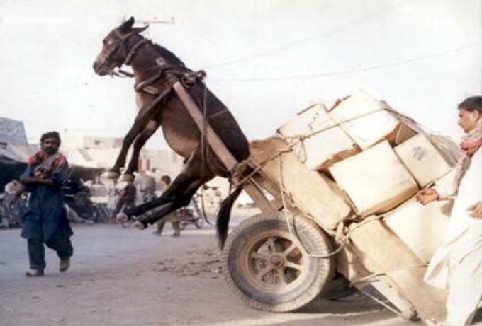
Financial Leverage
Equity
Debt
Too much
debt
Notes:
26

Slide 27
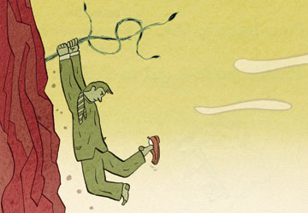
Should we help this bank?
Why are you in this position?
1.Mismanagement
2.Lack of supervision
3.Lack of Audit
4.Capitalist system
5.Political system
6.Ambition to grow & earn more money
BANK

Slide 28

Banks grew but how?
Unhealthy Growth of:
  Assets
  Net Income
  Equity
Resulted in high:
  Bonuses
  Dividends
  Share prices

Slide 29
Future of bankıng
Future Trends in Banking

Slide 30
Future Trends in Banking
1.Disintermediation
2.Globalisation
3.Big emerging markets
4.Centralisation of operations
5.Use of outsourcing services
6.Consolidation
7.Mergers and Acquisitions

Slide 31
Future Trends in Banking
8.Decrease in Net Interest Income margins
9.Growth in Non Interest Income Business
10.Technology to play an important role in bank success
11.New business with new partnership agreements
12.New Distribution Channels
13. Open Banking

Slide 32
Future Trends in Banking
14.New competition non bank financial and non-financial institutions
15.Franchising of certain bank branch functions
16.Importance of Supervision and Audit of banks will increase
17.New Laws and Regulations to limit the risks taken by banks
18. Behavioural Biometrics (passive&active)

