Slide 1
Bank Management Lecture #11
Bülent Şenver
bulentsenver@gmail.com

Slide 2
We will Learn This Week?
1. Loan Life Cycle
2. Non Performing Loans NPL Life Cycle
3. NPL Turkey Ststistics

Slide 3
Loan life cycle
Loan Life Cycle

Slide 4
Loan Life Cycle
1.Loan Product Development
2.Loan Marketing and Sales
3.Loan Application
4.Loan Quick Review, filtering
5.Loan Investigation

Slide 5
Loan Life Cycle
6.Loan Analysis (6 C’s Test)
Capacity Test
Character Test
Capital Test
Collateral Test
Compliance Test
Conditions Test
7.Loan Approval

Slide 6
Loan Life Cycle
8. Loan Approval Committees (LAC):
1) Board of Directors (LAC4)
2) Head Office Loan Approval Committee (LAC3)
3) Regional Office Loan Approval Committee (LAC2)
4) Branch Loan Approval Committee (LAC1)

Slide 7
Loan Life Cycle
9.Compliance to Loan Conditions
10.Sign Loan Agreement
11.Loan Disbursement, Loan Utilization

Slide 8
Loan Life Cycle
12.Loan Follow Up and Supervision
13.Loan Interest Payment
14.Loan Principal Payment
15.Loan Default, Non-Payment, or
16.Loan Closing

Slide 9
NPL – Non Performing Loan (Loan Default)
NPL Loan Life Cycle

Slide 10
Loan Default - NPL Life Cycle
1. Investigate the reason for Default (temporary or permanent)
2. Start “Close Supervision” & Follow Up
3. Classify Loan as Non-Performing Loans (NPL)
4. Reschedule the Loan, Change its Terms & Conditions

Slide 11
Loan Default - NPL Life Cycle
5. Provide a Reserve for NPL (debit expense)
6.Sell the NPL to a Collection Company, or
7. Classify NPL as Loans in Court

Slide 12
Loan Default - NPL Life Cycle
8. Start a Court Case
9. Sell Loan Collaterals, make collections
10. Get “Inability to Pay Court Certificate”
11. Loan Charge Off (remove loan & its reserves from accounts)

Slide 13
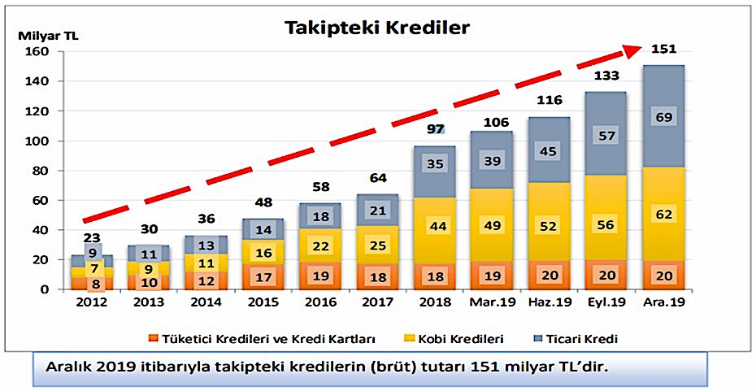
Non Performing Loans - Turkey
5.8%
4.1%
NPL/Total Loans
3.1%
3.4%

