Slide 1
Bank Management Lecture #10
Bülent Şenver
bulentsenver@gmail.com

Slide 2
We will Learn This Week?
1. Types of Loan Risks
2. Excessive Loan Growth Risk
2. 6 C’s of Loan Management
3. 5 P’s of Controlling Non-Performing Loan Management

Slide 3
Loan Management-Loan Risk
1. Default Risk, collection, recoverability risk
2. Yield Risk, return risk
3. Concentration risk
4. Diminishing security risk
5. Ethical risk
6.Big Loan Risk
7.Country Risk
8.Sovereign Risk

Slide 4
Loan Management-Loan Risk
9.Compliance risk
10.Indemnification risk
11.NPL Non-Performing Loan growth risk
12.Maturity missmatch risk
13.Profitability, yield risk
14.Capital Adequacy need risk
15.Reputation Risk due to illegal loan pocess
16. Excessive Loan Growth Risk

Slide 5
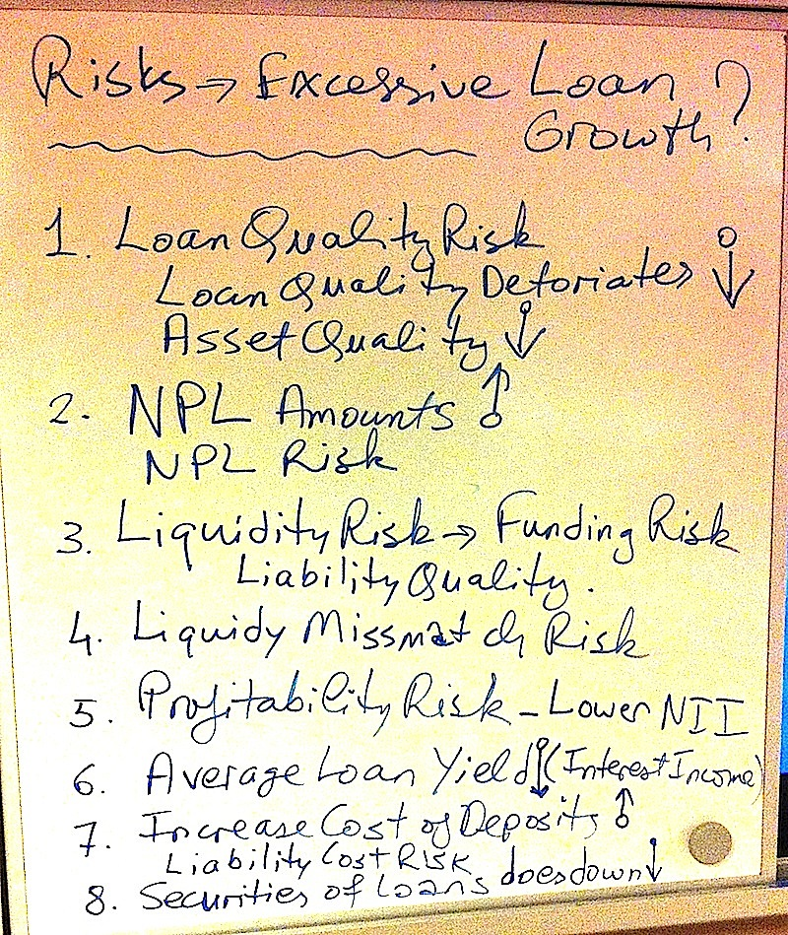

Slide 6
6 C’s of Loan Management
1. Capacity- The ability of a borrower to pay the loan back.
2. Character- Willingness of the borrower to pay the loan back
3. Capital – Is the borrower’s existing capital sufficient? Can the borrower’s share holders increase the capital of the company when needed?

Slide 7
6 C’s of Loan Management
4. Collateral- Can the borrower give to the bank proper collateral, guarantee to cover the loan in case there is a default in future?
5. Conditions- Is country, sector, holding, company & loan conditions suitable to give the loan?
6. Compliance- Does the bank & the borrower comply with laws, regulations & ethics?

Slide 8
6 C’s of Loan Management
4. Collateral- Can the borrower give to the bank proper collateral, guarantee to cover the loan in case there is a default in future?
5. Conditions- Is country, sector, holding, company & loan conditions suitable to give the loan?
6. Compliance- Does the bank & the borrower comply with laws, regulations & ethics?

Slide 9
5 P’s of Managing Non-Performing Loans
How to control NPL?
1. Philosophy
2. Policies
3. Procedures
4. Pricing
5. People

