Slide 1
Bank Management Lecture #1
Bülent Şenver
bulentsenver@gmail.com

Slide 2
We will Learn This Week?
1. Function of Financial Markets
2. Main Function of Commercial Banks
3. Commercial Banks’ Finacial Activities
4. Revenue Sources of Banks
5. Intermediation services of Banks
6. Needs of Bank Customers
7. Types of Banks

Slide 3
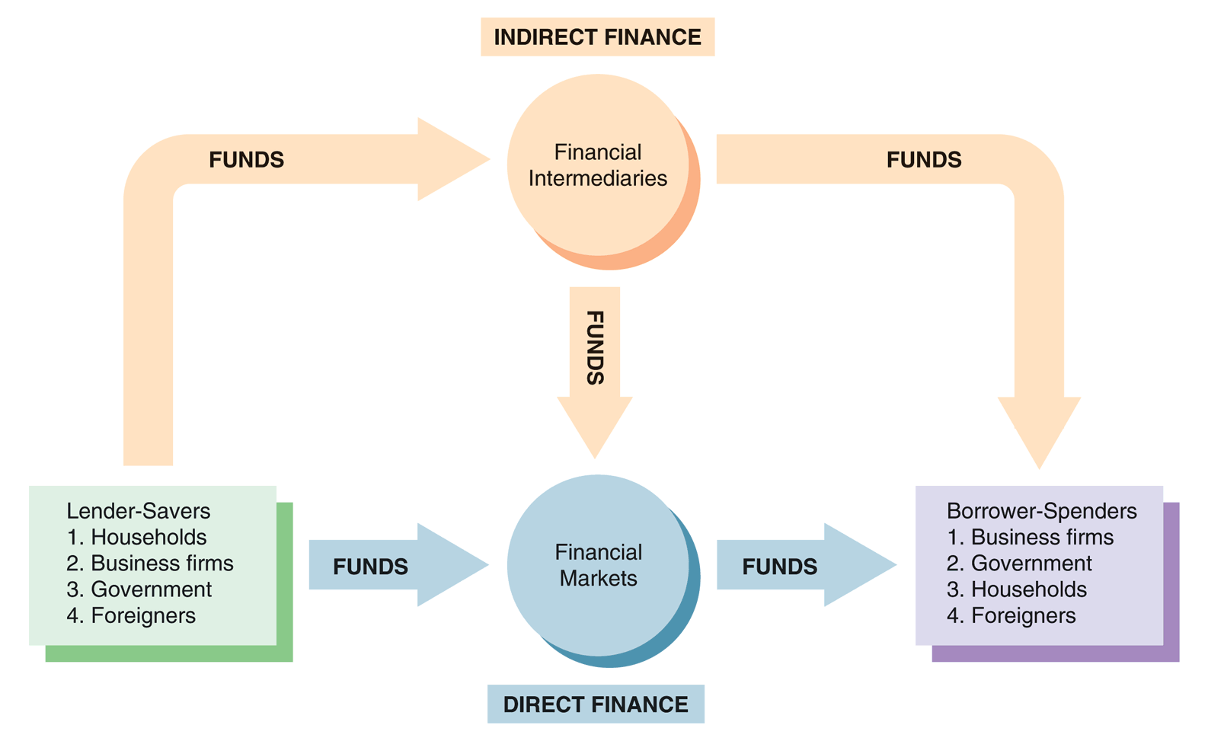
Function of Financial Markets

Slide 4
Comercial Banking
LOANS
DEPOSITS
Give
Get
Interest Income
Get
Interest Expense
Give

Slide 5
Comercial Banking
Interest Earning Assets
Interest Bearing Liabilities
LOANS
DEPOSITS
IEA
IBL
Net Interest Income
Interest Income
Interest Expense

Slide 6
Revenue Sourses of Commecial
Revenue 1
Revenue 2
+ Interest
Income
+ Non Interest
Income
Net Interest Income
Net
Non Interset Income
Expense 1
Expense 2
Interest
Expense
Non Interest
Expense
Net Income Before Tax

Slide 7
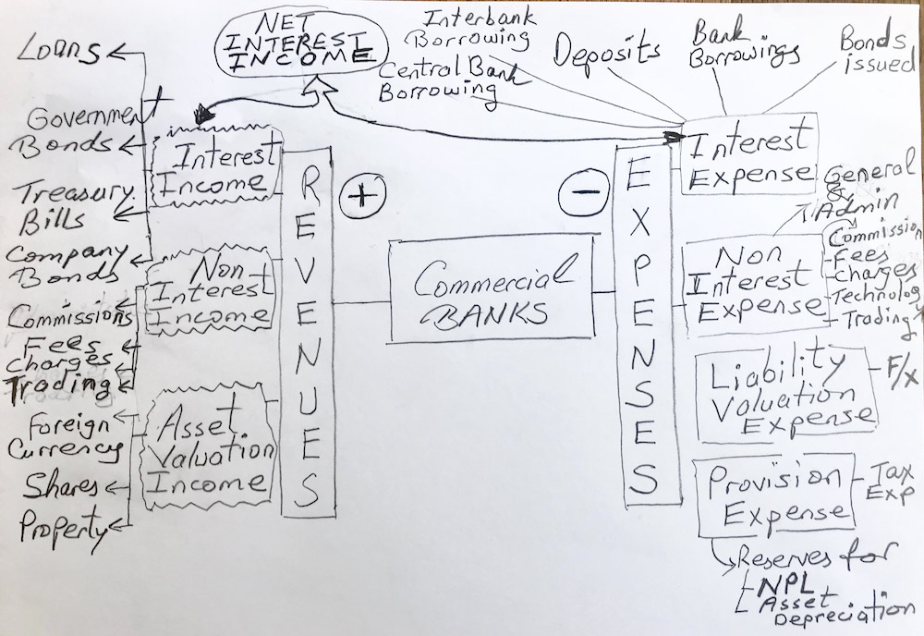
Commercial Bank Revenue & Expense Map

Slide 8
Bank Intermediation Services
Related Risks:
1. Concentration R (Big Deposit R or Big Loan R)
2. Foreign Exchange Position
3. Liquidity R (S/T Deposit vs L/T Loan)
4.Net Interest Income R
5. Sensitivity Gap R (fixe rate Deposit vs variable rate Loan)
6. Recoverability (insufficient gurantee)
Intermediation Type:
1. Denomination
2. Currency
3. Maturity
4. Interest Rate
5. Interest Sensitivity
6. Security-Collateral

Slide 9
Banks Target 7 Needs of Customers Needs: Products:
1. Savings need
2. Borrowing need
3. Investment need
4. Security need
5. Trading need
6. Payment need
7. Advice & consulting need
1. Term-Deposits
2. Loans
3. Securities, Government Bonds, Treasury Bills, Company Bonds, Mutual Funds, Certificate of Deposits, Commercial Papers, Mortgage Backed Securities, Asset Backed Securities,
4. Insurance products, Derivatives, Forwards, Swaps, Options, Hedging
5. Buy & Sell Foreign Currencies & Bonds, Shares, Precious Metals, Commodities
6. Cash, Cheques, Promissory Notes, Credit Cards, Debit Cards, ATM, POS, EFT, SWIFT
7. Asset management, Wealth Management, Investment Banking

Slide 10
Financial Intermediaries Types of Banks
Commercial Banks
Investment Banks
Merchant Banks
Islamic Banks (participation banks)
Development Banks
Off-Shore Banks
Special Purpose Banks

